Slide 1
AIOT website
Website layout:
https://xd.adobe.com/view/d8b2faa6-1e7b-43f1-a607-f969180ee496-8de1/
index
about-main
product-main
project-main
about-spage
product-spage
project-spage
blog-main
blog-spage
membership
register
log in
order
article mangement
edit profile
give us feedback
article edit page

Slide 2
index
Slider
3 box to introduction
Slogan
about area
Video area
Blog area

Slide 3
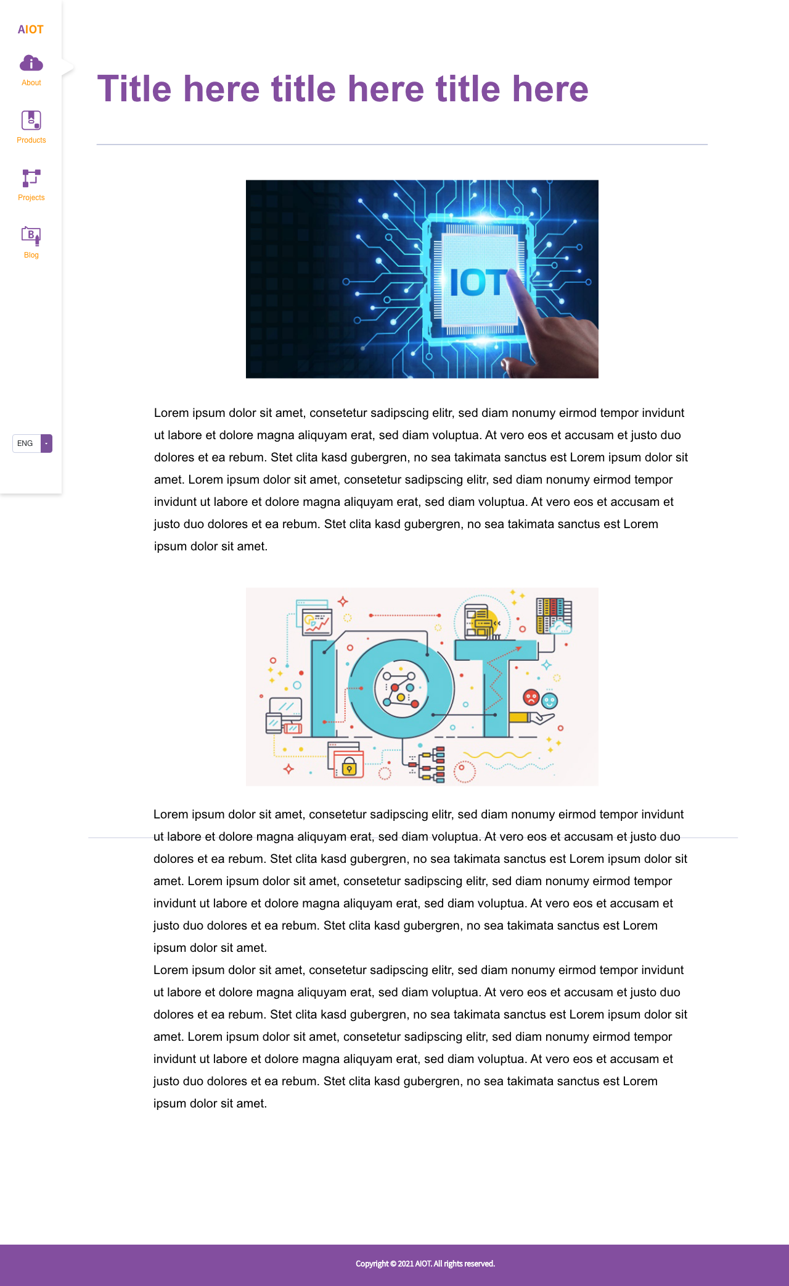
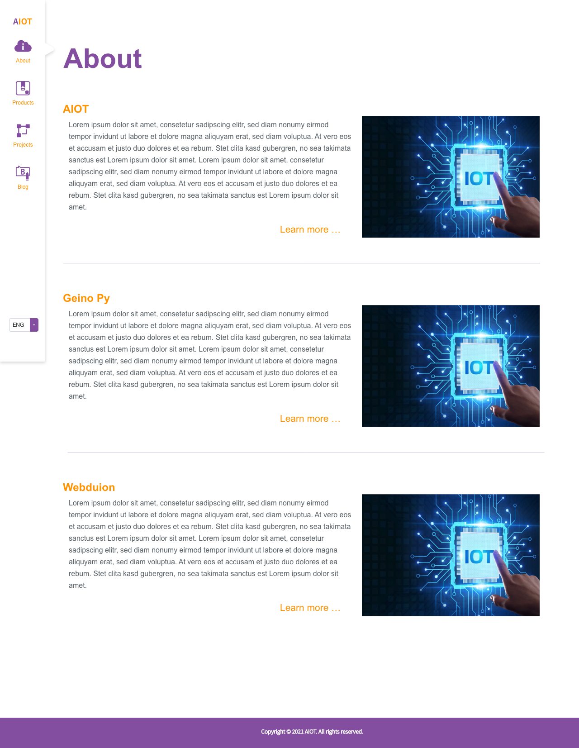
about
Main page
title
Summary
image
Link
Spage
title
Content : text and image

Slide 4
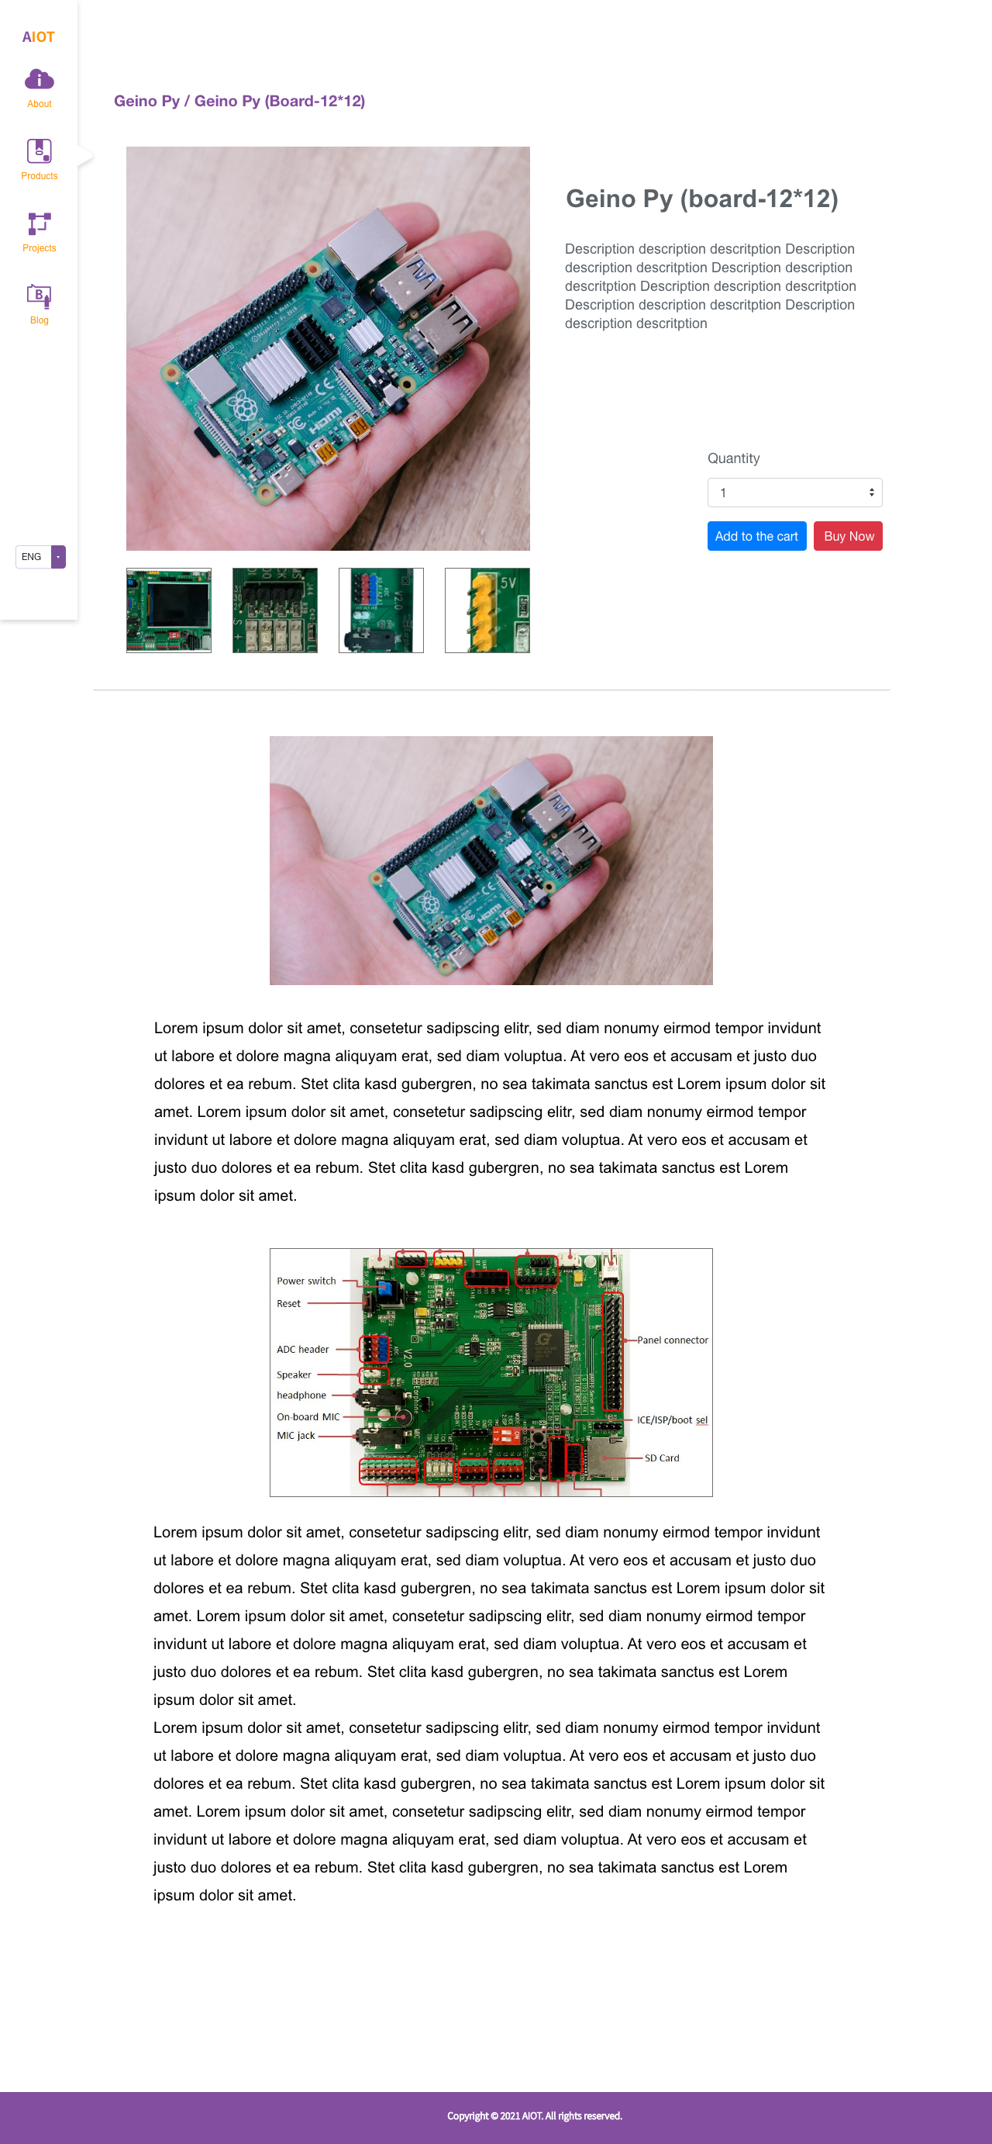
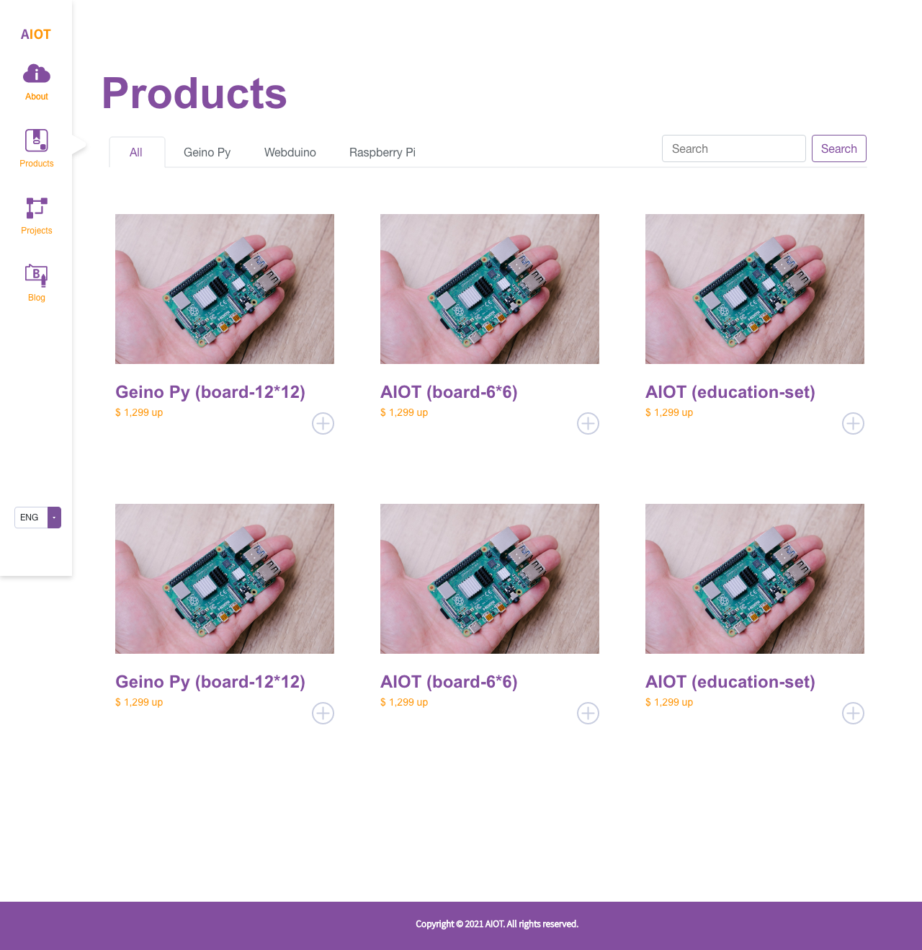
product
Main page
Navbar ( include searchbox)
Product :
Image
Title
Price
Add to the cart
Spage
image
title
Information
Quantity
Button
add to the cart
buy now
Content : Text and image

Slide 5
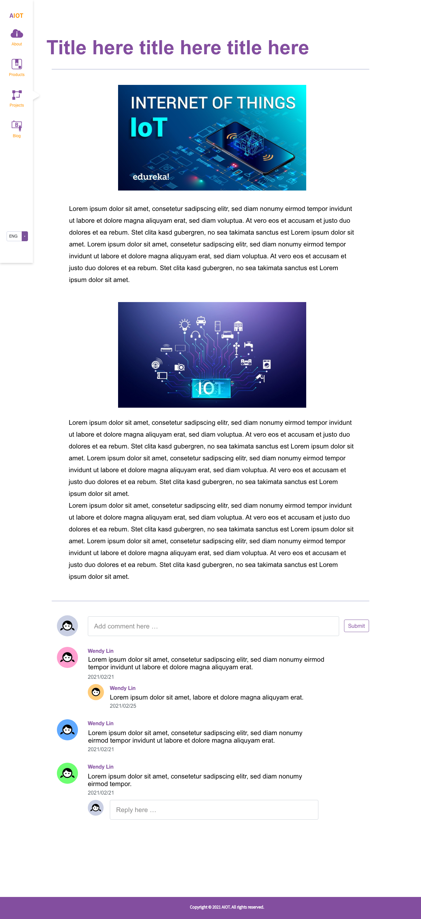
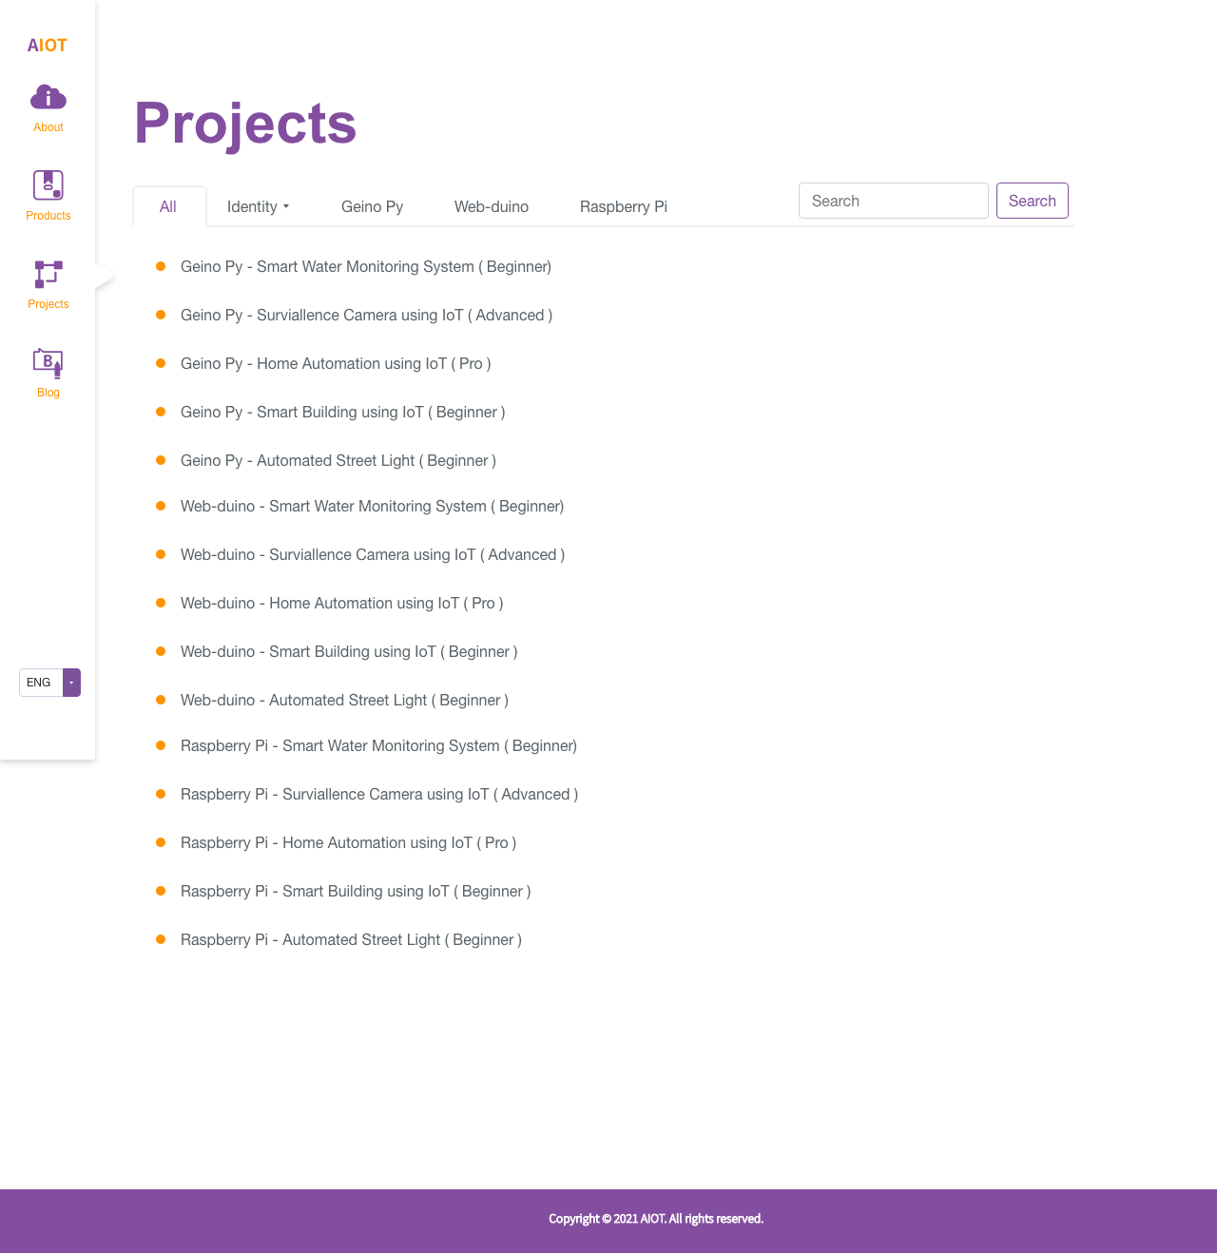
project
Main page
Navbar ( include searchbox)
Project list
Spage
title
Content : Text and image
Comment area

Slide 6
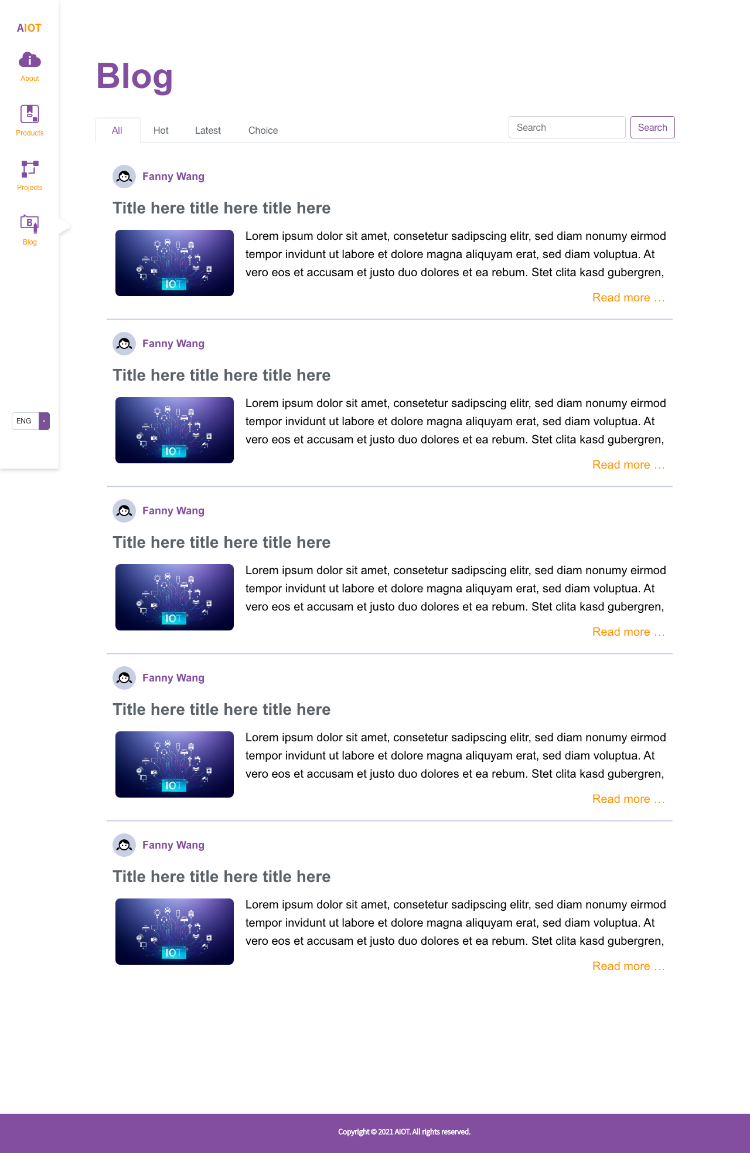
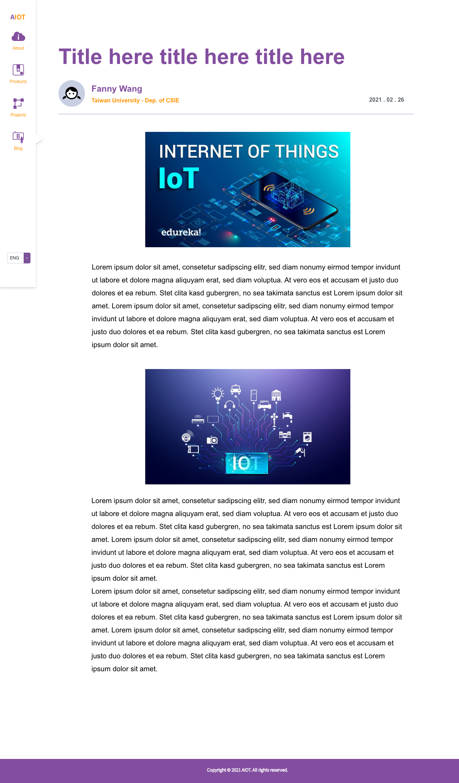
blog
Main page
Navbar ( include searchbox)
article list
Spage
Artiale author
profile picture
Name
school
date
Content : Text and image

Slide 7
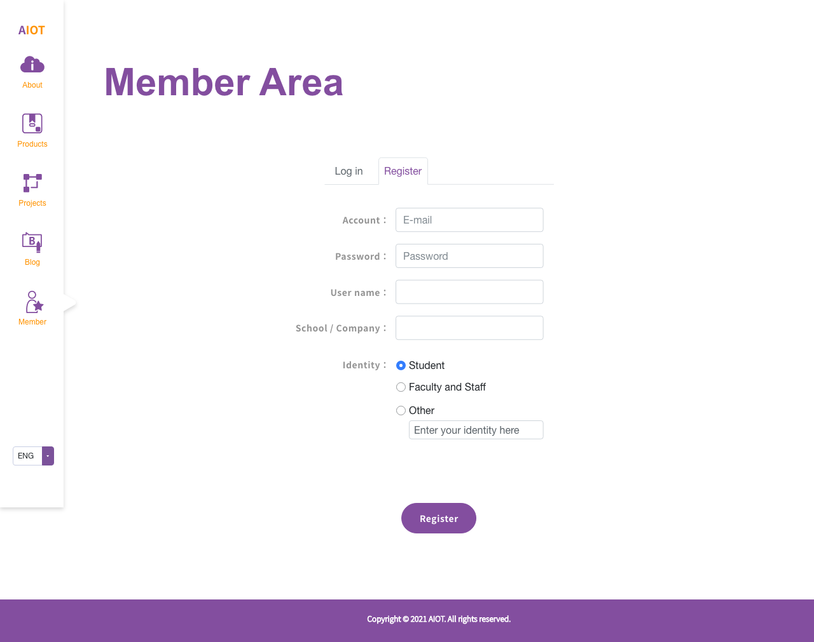
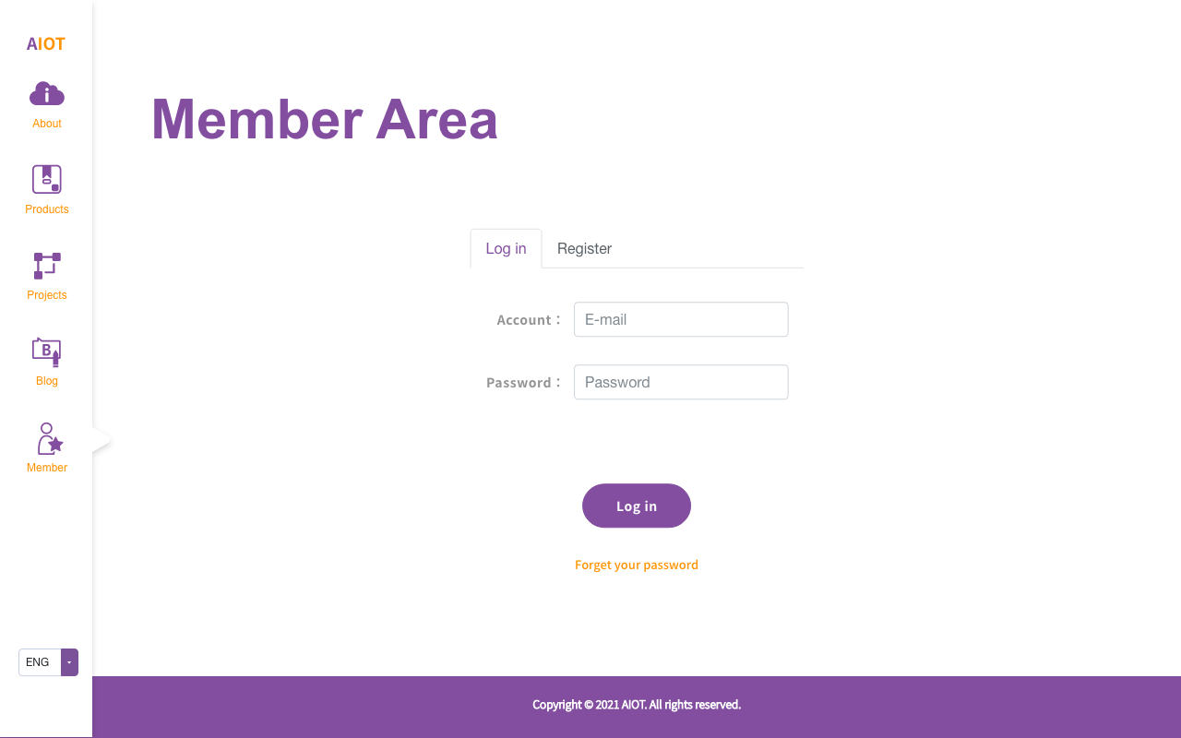
Member area
Log in
register

Slide 8
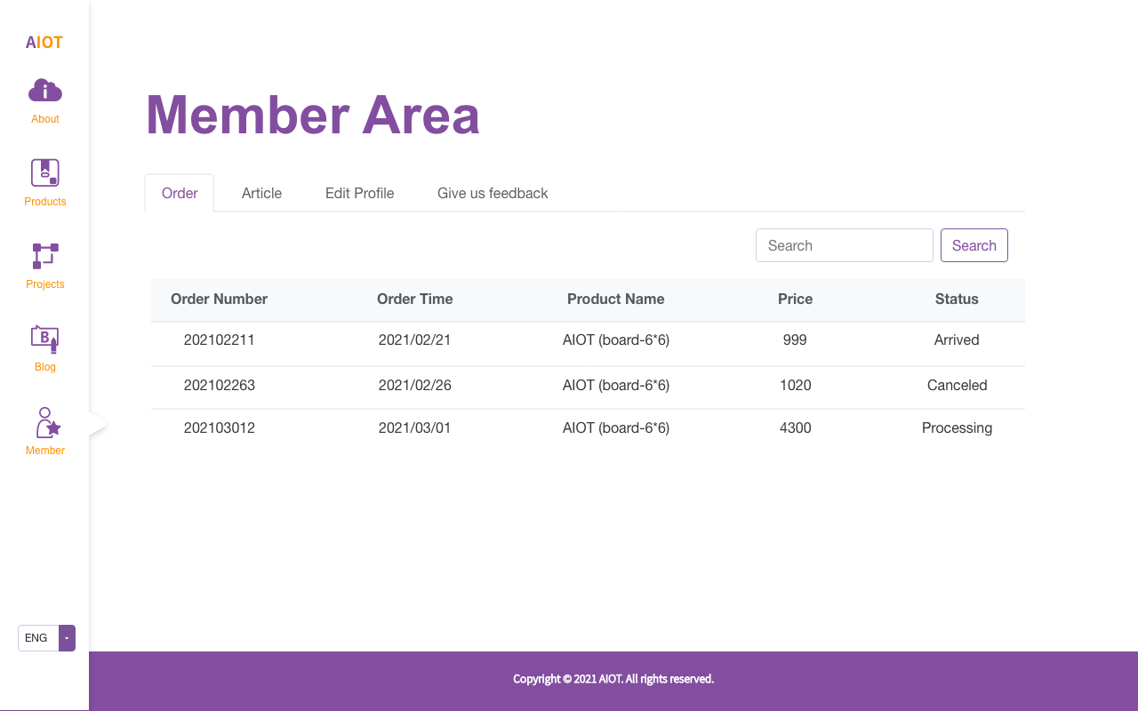
Member area
order
Search box
Tables
Order number
Order time
Product name
Price
ststus

Slide 9
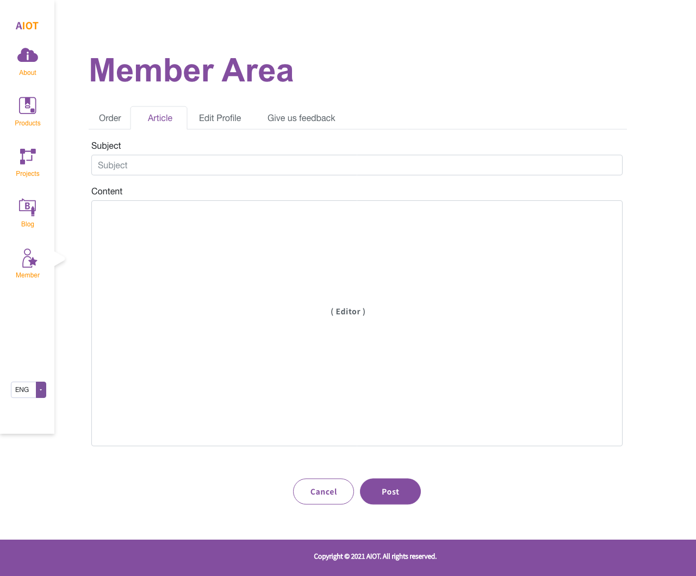
Member area
Article-main
Creative new article
Search box
Tables
Date
Article title
Edit (to the editor page)
Delete (modal)
Article-edit page
Subject
Content ( editor )

Slide 10
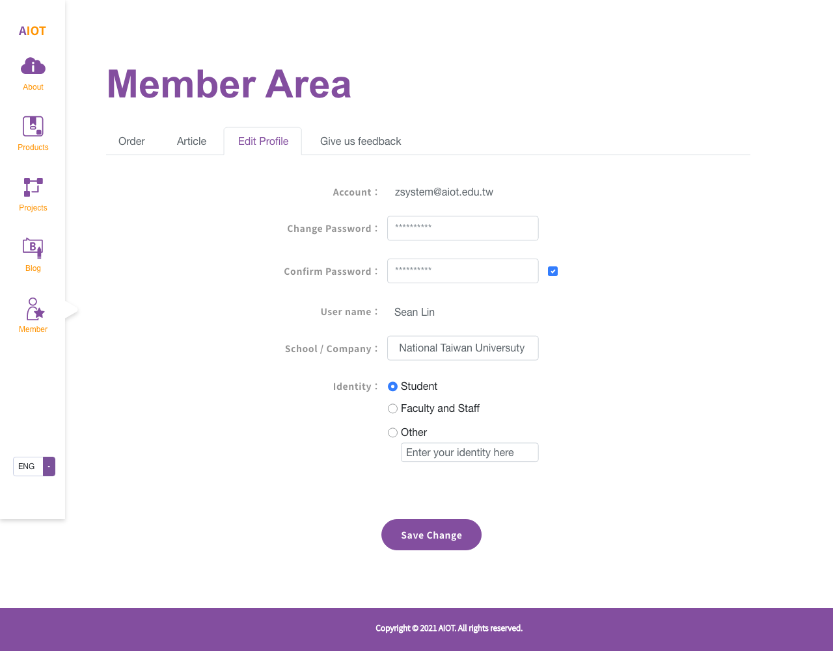
Member area
Edit profile
Cannot edit :
Account
User name

Slide 11
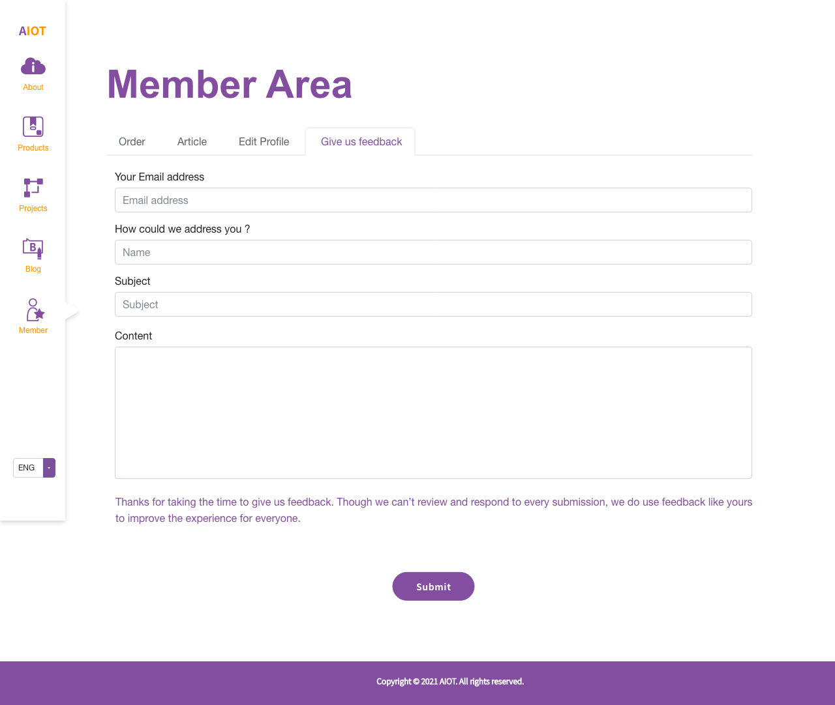
Member area
Give us feedback

