Slide 1
公館APP First report
2020/11/25

Slide 2
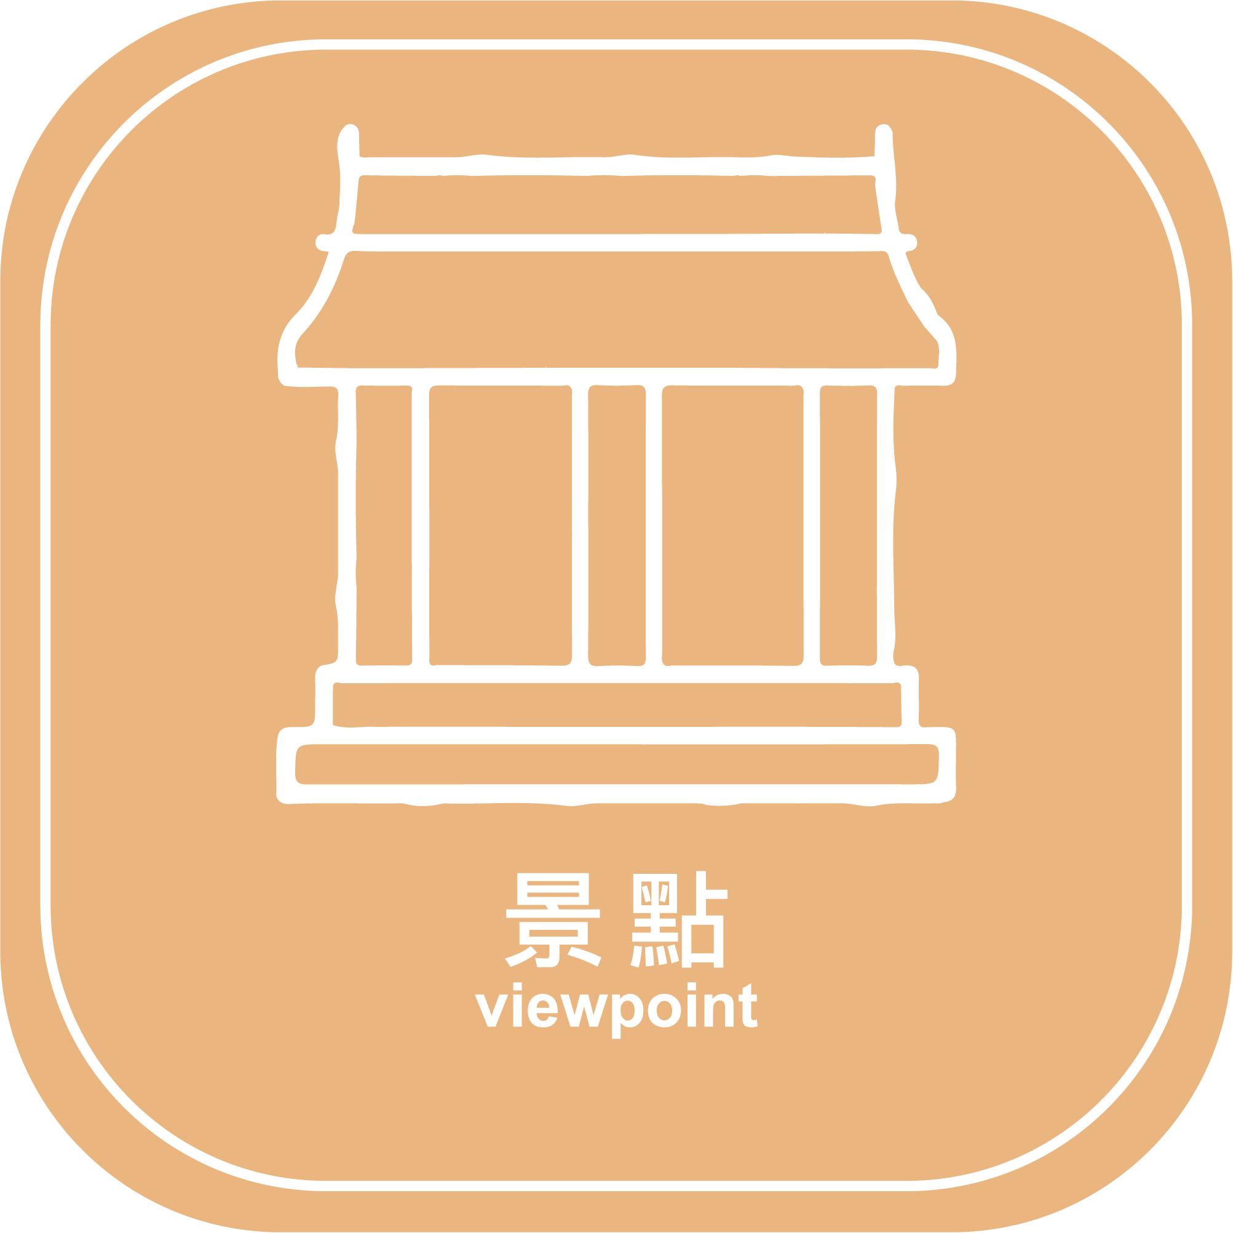
1.Store
2.Hotels
Sort order adjustment
3.View point
4. For Dummies
5.Agri Product
6.Hosiptal
7.traffic
8.abouts
These two icons have not been drawn up yet
No.8 Use Case3 Module

Slide 3
項目:category
Spec
1.名稱
2.介紹
3.產品照片
架構
Architecture
Case1
*Mainly classified three cases
according to number(red color number)
Corresponding to case1 case2 case3
農產品
1
2
特色店家
Use Case1
No.1
Spec
1.名稱
2.介紹
3.地址,電話
4.照片(有的話)
5.Google map 座標
Case2
民宿
3
Welcome
Page
景點介紹
4
Use Case2
No.2
No.3
No.4
No6
5
交通指南
醫療
6
Spec
類似blog
Case3
懶人包
Use Case3
No.5
No.7
No.8
7
8.abouts
⭐New add No8 item , This use Case3 Module
關於我們

Slide 4
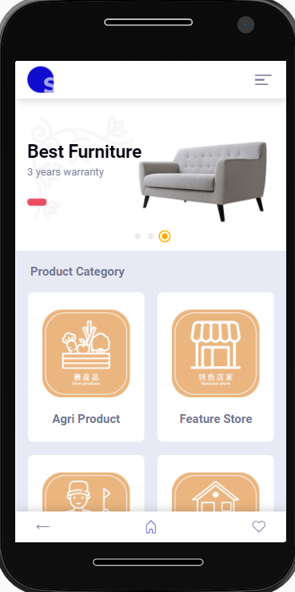
Need Search Function

